Slide 1
Integrated Payroll Management and Payment Reconciliation System
For the Social Pension Program of DSWD Field Office XII
Presented by: Alden A. Quiñones

Slide 2
Introduction
The Social Pension Program supports senior citizens without formal pensions.
Disbursement remains manual, leading to delays and inefficiencies.
Identity verification issues cause delays and fraudulent claims.
A technology-driven solution is needed for accuracy and efficiency.

Slide 3
Problem Statement
Data inconsistencies due to lack of quality assurance in beneficiary endorsements.
Manual processing delays disbursement and liquidation.
Difficulty tracking beneficiary status affects payroll preparation.

Slide 4
General Objective
To develop an Integrated Payroll Management and Payment Reconciliation System that ensures data quality, accuracy, and efficiency in disbursement, reducing fraud and streamlining operations.
Specific Objectives
Develop a system to detect and eliminate duplicate/fraudulent entries.
Automate payroll processing and payment reconciliation.
Enable real-time tracking and updating of beneficiary status.

Slide 5
Specific Objectives
Develop a system to detect and eliminate duplicate/fraudulent entries.
Automate payroll processing and payment reconciliation.
Enable real-time tracking and updating of beneficiary status.

Slide 6
Proposed Solution
A centralized web-based system for automated payroll and reconciliation.
Data validation algorithms to prevent fraud.
Real-time tracking of beneficiary status for accuracy.
Secure and scalable system with access control.

Slide 7
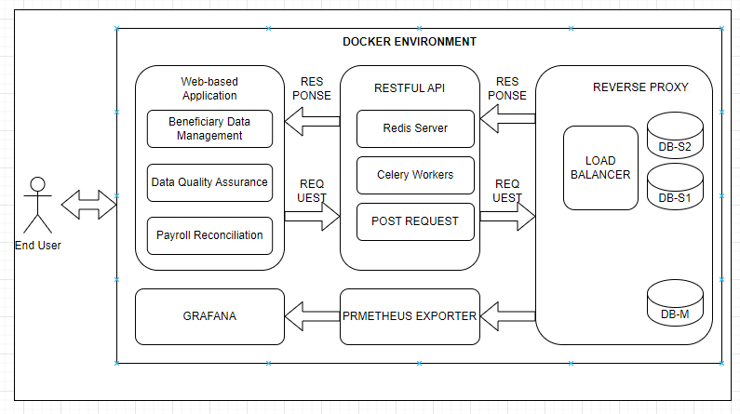
Conceptualized Framework

Slide 8
Methodology & Technologies Used Software Requirements
CodeIgniter 3 for web application development.
Python Flask RESTful for backend data streaming.
Redis and Celery for handling large data processing.
Docker, Prometheus, and Grafana for monitoring and scalability.
SSL Certificate

Slide 9
Methodology & Technologies Used Hardware Requirements
OCP Server
Global Protect
LDAP Active Directory Credential

Slide 10
Expected Outcomes
Faster and more accurate payroll processing.
Reduced fraudulent claims and duplicate beneficiaries.
Streamlined disbursement and reconciliation process.
Reduce Grievances

Slide 11
END OF PRESENTATION

